Slide 1
Chapter 3 - Signature

Slide 2
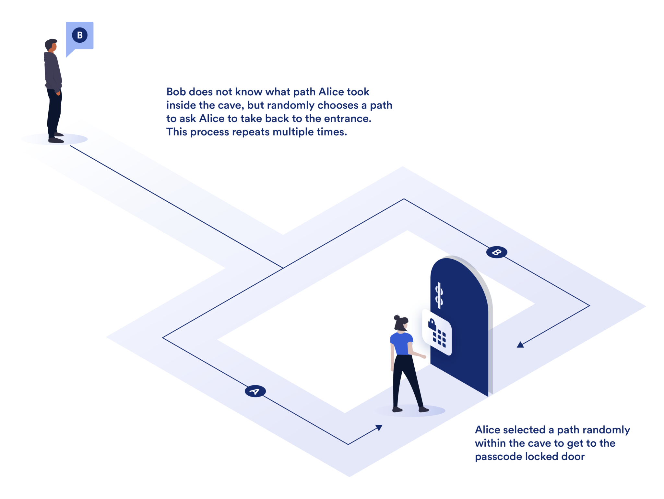
Section 3.1 - Σ-protocols and the Fiat-Shamir Heuristic
Interactive Proof of Knowledge
Zero-knowledge

Slide 3
Endomorphism Ring
An endomorphism given an elliptic curve is an isogeny, φ : E → E
(f+g)(P) = f(P) + g(P)
(f o g)(P) =f(g(P))

Slide 4
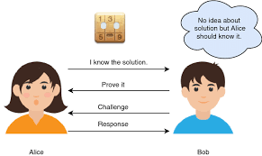
Three interactive phases
Public key: E_{A}
Private key (knowledge): End(E_{A})
Commitment: Prover randomly generates (E₁, End(E₁)). Sends E₁ to verifier.
Challenge: Verifier randomly generates φ_{chall} : E₁ → E₂ and sends φ_{chall} to prover.
Response: Prover uses End(E₁) and φ_{chall} to compute End(E₂). Then uses this and its knowledge to compute φ_{resp} : E_{A} → E₂. Sends this to Verifier
Verifier who has the public key and E₂ can easily check if φ_{resp} is a correct isogeny

Slide 5
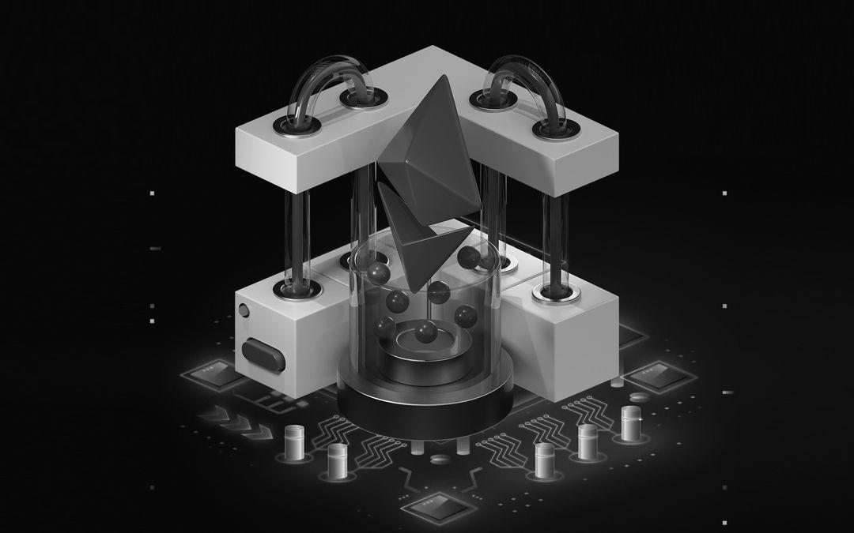
Fiat-Shamir Transform
Interactive to non-interactive proof of knowledge
Single signing and single verifying stage without explicit communication
Key difference is prover computes its own challenge using an unpredictable hash function that changes drastically for different commitments or different messages

Slide 6


Section 3.3 - Key Generation
SQIsign.KeyGen Algorithm
Then a secret ideal is computed: I_{secret} = 𝑂₀ (γ(𝑎 + 𝑖)) + 𝑂₀(𝐷_{secret})
Connecting quaternion is found and used to find a connecting ideal

Slide 7
Section 3.3 - Key Generation
B_{0, T} is a basis for E₀[T], the T-torsion subgroup of E₀.
φ_{secret} maps B_{0, T} to the basis for T-Torsion subgroup of E_{A}.

Slide 8


Section 3.3 - Key Generation
P and Q are basis points.
The secret isogeny is applied to Q.
The signing key (the knowledge) is the connecting quaternion, basis of T-torsion subgroup of E_{A}, and mapped basis point Q

